Slide 1
Collaborative Software Development
Paul M. Nguyen
CECS-475, Donna Pompei
April 28, 2009

Slide 2
The Problem
Many developers work on a single project?
Determine current version of code or docs?
How can we efficiently and accurately combine changes to the same file by multiple developers at the same time? Or changes to multiple files at the same time?
Someone broke the code; let's go back to the last version that worked.

Slide 3
The Problem (cont'd.)
What design considerations went into this component?
Was someone planning to work on this component?
What are the big issues/bugs/features that we are focusing on?

Slide 4
The Solution
Collaborative source code management
Collaborative documentation management
Collaborative bug/issue tracking system

Slide 5
Source Code Management (SCM)
Solves all of the coding problems in some way:
  Multi-user
  Builtin Diff tool
  Keeps previous versions of all files, in a software-development-conscious manner
  Ability to manage parallel development

Slide 6
Basic Features and Principles
Repository (repo): the entire stored history of the project, possibly with tags
Working Directory (WD): usually the latest changes, not necessarily in the repository
Commit: save WD changes to repo
Synchronize: push local changes to another repository or pull remote changes to the local repository.

Slide 7
Extended SCM Features
Branch: copy the repository so that development can proceed in parallel or diverge (branch) and commits can be made in each branch exclusively.
Tag: Give a special name (usually a version number) to a specific revision (the state of the code) at a point in the history of the project

Slide 8
Client-Server SCMs
Repository resides on server; clients checkout revisions, not the whole repository.
CVS: Concurrent Versioning System
SVN: Subversion: same philosophy as CVS, but atomic commits and better access methods.
Microsoft Visual SourceSafe: bad news

Slide 9
Common Distributed SCMs
Every WD has a full repo in it – fully self-contained repository and working directory.
Git: the SCM used for the Linux Kernel
Bazaar: made to be very easy to use
Hg: Mercurial: svn-like interface

Slide 10
Mercurial
Very fast; written in Python
Can archive tip revision in a simple format like Zip or tar.gz and transmitted over FTP or HTTP.

Slide 11
Getting Mercurial
You only need the Windows shell extension client: TortoiseHg or the command-line client for Linux or Mac.
You can optionally synchronize your local work with a central repository (like BitBucket - sign up for a free account)

Slide 12
Mercurial Workflow
Pull changes from central repository.
Change code; commit changes locally.
Pull changes from central repository.
Reconcile any conflicts.
Push changes to central repository.

Slide 13
Considerations in CECS Lab
You cannot add the TortoiseHg extension to Windows in our labs.
You can, however, install hg to your user account in Linux, and use an SSH session while in the Windows labs to manipulate your Mercurial repository while working with your files in Windows (they are all in the same place).

Slide 14
Installation (CECS Account)
Download Mercurial binaries for Linux.
Place into your ~/tmp directory.
Unpack it with tar xzf {file.tar.gz}
Run make install-home
This created a few directories in your home directory and added the executable files to them.

Slide 15
Post-Install Configuration (CECS)
Add two lines to your ~/.cshrc file:
  set path = ($path ~/bin)
  setenv PYTHONPATH = ($PYTHONPATH ~/lib/python2.5/site-packages/hgext ~/lib/python2.5/site-packages/mercurial)
Create the file ~/.hgrc with the following contents:
  [ui]
  username = Paul M. Nguyen <paul@pnguyen.net>
Restart your shell with exec csh

Slide 16
BitBucket Mercurial Hosting
Provides a central repository for team members to clone to their systems and update against.
150MB Free; many contributors allowed.
SSH-encrypted and authenticated access to repo.

Slide 17
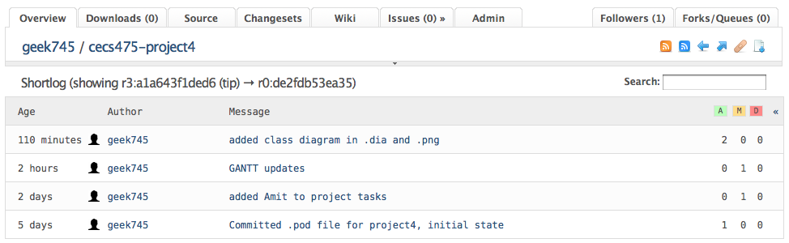
BitBucket Project Overview

Slide 18
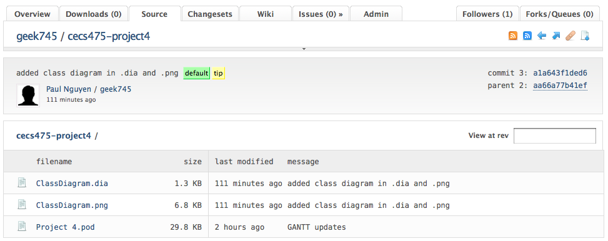
BitBucket Source View

Slide 19
Mercurial Wrap-up
Read the Mercurial book at http://hgbook.red-bean.com/
Use the official website and community at http://www.selenic.com/mercurial
Questions?

Slide 20
Documentation Management
For design considerations
For quick reference of relevant technologies or similar projects
For general information used by the team in the course of development
For end-user manuals or instructions

Slide 21
BitBucket's Wiki
The Wiki document paradigm is perfect for collaborative software development – versioned, multi-user, web-based.
Very easy to use

Slide 22
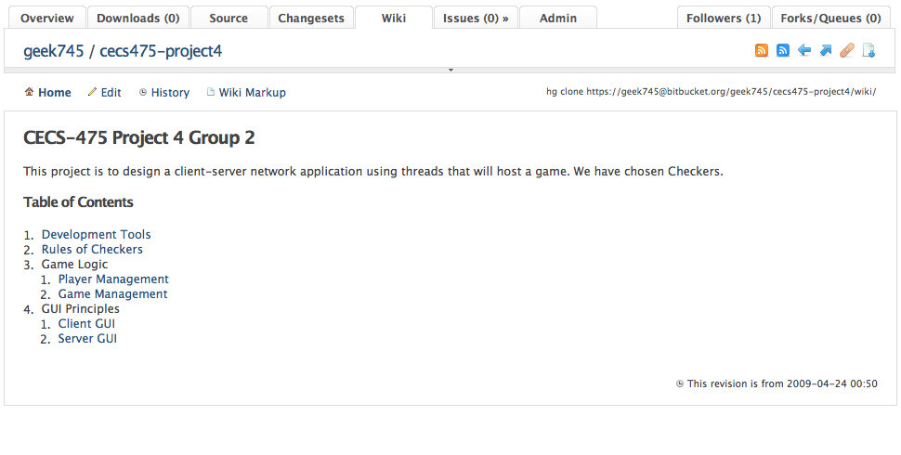

Slide 23
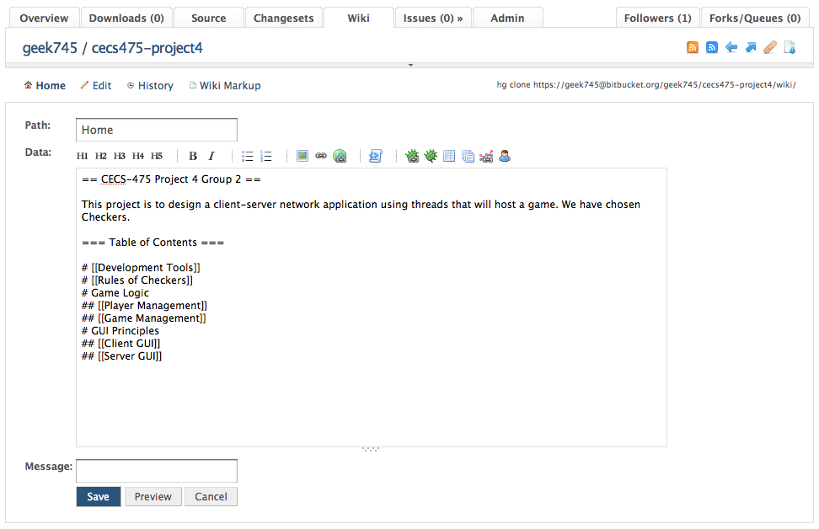

Slide 24
Bug/Issue Tracking
Important to be able to track bugs in code and track what efforts are made to fix these bugs.

Slide 25
BitBucket Issue Tracking
BitBucket offers “Issues” feature to help track bugs and status of developers at fixing them.

Slide 26
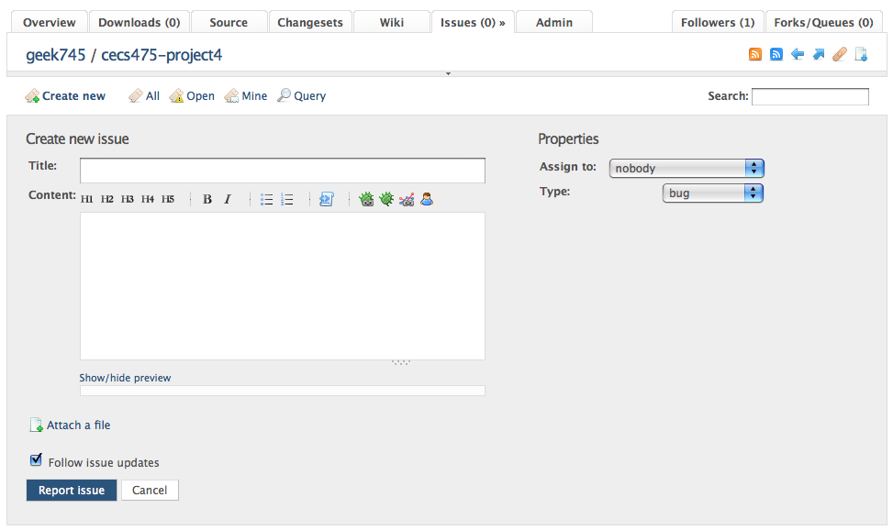
BitBucket Issue Tracking

Slide 27
Questions?

